Slide 1

Soccer Event Detection
By Michele Attilio Iodice

Slide 2

Topic
Football is one of the most famous and followed sports in the world; its allure attracts millions of spectators. Thanks to the giant strides made by technology in recent years, those working in this sector have been able to leverage technical support for analysis and statistics. The systems have been developed through the study of new techniques and methods, such as machine learning (ML), for image and/or video processing their purpose in this context is to detect football-related events and generate useful statistics for those working in this field.

Slide 3
Goals
what we aim to achieve with our method is to accurately distinguish whether an image is an highlights of the soccer match or not, and if it is an highlights, associate it with the correct corresponding event of the soccer match like:
Coroner
Free-Kick,
Penalty-Kick
Substitution
Tackle
Red-cards
Yellow-cards.

Slide 4
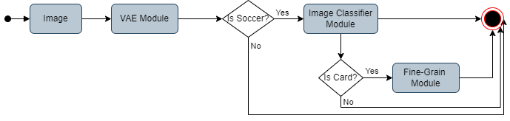
Proposed Method
The proposed method is divided into three parts:
The image is passed through the variational autoencoder. If the loss of the VAE network is less than a certain threshold, then the input image is considered to be a match event.
The image classification module assigns a specific event to the input image. If the event corresponds to one of the 7 categories(penalty kick, corner kick, tackle, free kick, or substitution) is a soccer event otherwise no.
The fine-grain classification module, classified th event falls into the Cards category which distinguishes whether the image is a red or yellow card, associating the card’s color with the image.

Slide 5
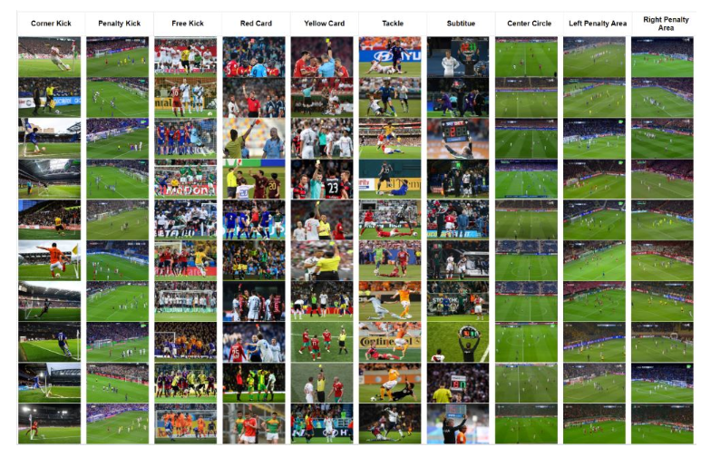
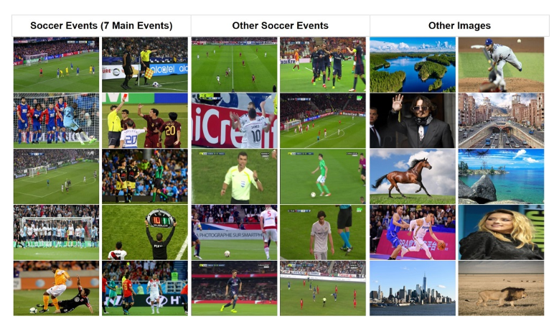
Dataset
We use a Soccer Event Dataset (Image) were was collected two image datasets of a football match:
the Soccer Event (SEV) dataset covering the football match events.
the Test Event dataset used to assess the proposed architecture.

Slide 6
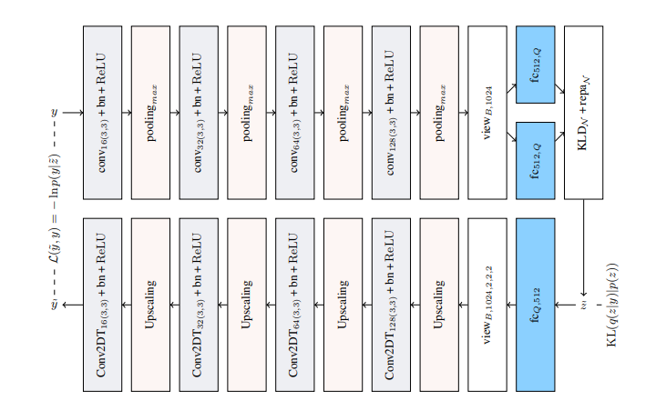
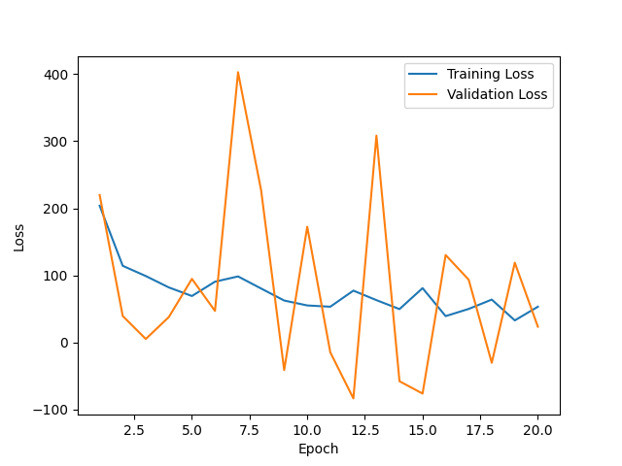
VAE module
The VAE network is therefore used to identify if the input image is similar to those contained in the SEV dataset.

Slide 7
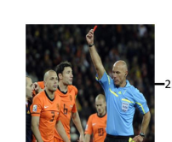
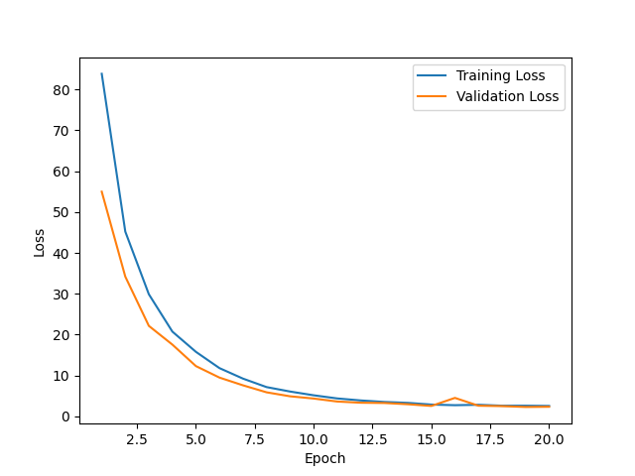

Image Classification module
The image classification module is tasked with associating one of nine categories with the input image with a certain degree of accuracy.

Slide 8
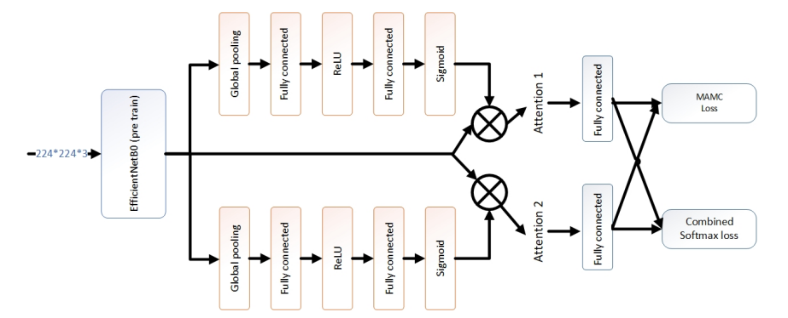
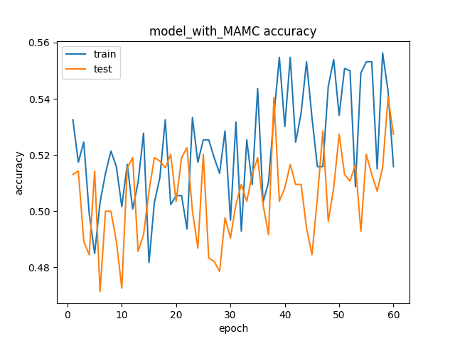
Fine-Grain Classification module
The Fine-Grain classification module is a specialized network developed solely to distinguish images representing the card and separate them into two classes: red card and yellow card.

Slide 9
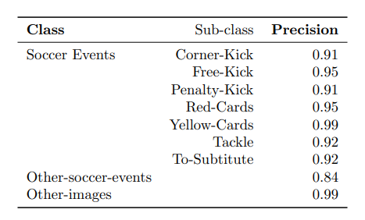
Test and Evaluation
The accuracy metric is used as the main metric; recall and F1-score are also used to determine the appropriate threshold value of the network. Also, precision is used to evaluate the performance of the proposed method to detect events.
The various components of the proposed method were evaluated separately to find the best model for classifying the images then they are combined into a single algorithm in which the images are first passed to the VAE model (no highlights?), after passed to the image classification model (which is the class?) and if is a Card is passed to the fine-grain classification model(is red or yellow cards?).

Slide 10
Conclusion
The obtained results indicate that the proposed method has a high level of accuracy in recognizing the events of the soccer match, which was the objective we aimed to achieve. The final method achieves an accuracy of approximately 93%.
Possible future work development could be:
• expanding the training dataset by providing more samples for each category.
• introducing new categories of events related to the match.
• developing algorithms for analyzing the recognized events.
• using this method as a data preprocessor for other systems.

Slide 11
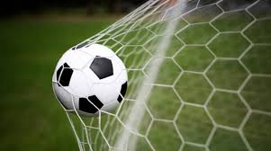
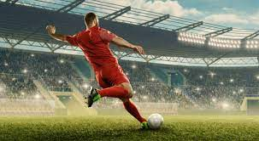
Thank you for your attention!

